Slide 1



A to Z: An Introduction
to Ansible on z/OS
Richard Gamblin

Slide 2
What is Ansible?
Key Capabilities
FLEXIBLE Ability to proactively manage your entire application environment
AGENTLESS No additional software is needed on target system
PARALLEL AUTOMATION Ability to drive automation to multiple systems simultaneously
INFRASTRUCTURE AS CODE Allows clients to codify their application IT landscape
Benefits
FREE Ansible is an open-source tool
INTEGRATE IBM Z into an enterprise automation strategy in a consistent way
SIMPLICITY Strong focus on security and reliability
COMMON APPROACH To hybrid applications and infrastructure management
VIBRANT ECOSYSTEM with many active contributors
Ansible is a hugely popular Open-Source software provisioning, configuration management, and application-deployment tool.
It is highly customizable through Playbooks (simple, highly customizable scripts that are used to execute a series of tasks and commands)
In the open distributed world, Ansible is seen as the key to automating everything.
Automation simplifies complex tasks, allowing developers & ops teams to focus attention on other tasks that add value to an organization.
It frees up time and increases efficiency.
2

Slide 3





Why use Ansible with z/OS?
Consistency
Enables common approach to hybrid applications and infrastructure management
Integrate z/OS into an enterprise automation strategy in a consistent way
Transparency
Enable transparent visibility of z/OS automation when orchestrated by Ansible
Drive best practices to manage automation in source control, towards infrastructure as code
Skills
Ansible and Python skills are readily available in the marketplace
They can now be as equally applied to z/OS as any other platform
Simplify
Keep it simple.
Ansible is not about replicating complexity, it is about simplifying configuration and access.
Work with what you have
Ansible is very flexible and works with everything; it isn’t out to rule the world, rather interact with it
Integrate with what you have or build new playbooks with certified Open-Source
Leverage existing JCL, REXX and z/OSMF assets and more with Ansible as an integration point
The choice is yours.
3

Slide 4
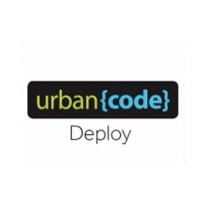









Ansible in the z/OS ecosystem
Leverage Ansible content across multiple solutions
Liberty
MQ
CICS
z/OS Connect
CI/CD
(Ansible Playbooks/Roles)
z/OSMF
Db2
IMS
Middleware management
(Ansible Playbooks/Roles)
SA
z/OS Cloud Broker
(Ansible Playbooks/Roles)
System Automation
(Ansible Playbooks/Roles)
These solutions can either be automated using Ansible or can leverage Ansible content in the form of playbooks, roles, or raw Python modules
Notes:
How valuable is the ability to use a common provisioning stack across the enterprise for both infrastructure as code and application deployment?
Does your enterprise use Ansible (and Ansible Tower)? If not, what is the approach for both distributed and z/OS infrastructure?

Slide 5



Red Hat Ansible Certified Content for IBM Z
Red Hat Ansible Automation Platform is the enterprise framework for Ansible that enables a common approach to hybrid applications and infrastructure management
Flexibility
Bring disparate IT into a coherent whole using a market leading open solution backed with enterprise support
Interact directly with z/OS resources or integrate with existing platform tools
Red Hat Ansible Certified Content for IBM Z
Set of collections that accelerate the use of Ansible with IBM Z
Initial collection focuses on the basic building blocks of interacting with the z/OS system
Collections will be added regularly covering additional use cases (ex. configuration, provisioning, application deployment) for z/OS and the broader IBM Z community
Consistency
Integrate z/OS into an enterprise automation strategy in a consistent way
Centralize management of your IT infrastructure
Simplicity
The certified collections codify much of the z/OS specific knowledge and complexity
Developer or system programmer can focus on their tasks and be more productive

Slide 6





Automation with Ansible: z/OS
DevOps
Playbooks
Inventory
RED HAT ANSIBLE ENGINE
SSH
REST
ZOAU
RSA
#!/bin/bash
Unix System Services
Unix Files
Datasets
TSO Environment
MVS Programs
JES Environment
z/OSMF
z/OS

Slide 7






Automation with Ansible: z/OS and other Cloud platforms
DevOps
RED HAT ANSIBLE TOWER
Playbooks
Inventory
RED HAT ANSIBLE ENGINE
SSH
REST
ZOAU
RSA
#!/bin/bash
Unix System Services
Unix Files
Datasets
TSO Environment
MVS Programs
JES Environment
z/OSMF
Other Cloud
Platforms
z/OS

Slide 8
Automation with Ansible: vocabulary
---
- hosts: zos_host
collections:
- ibm.ibm_zos_core
gather_facts: no
vars:
tgt_tmp_dir: "/tmp"
ctl_tmp_dir: "/tmp"
environment: "{{ environment_vars }}"
connection: ibm.ibm_zos_core.zos_ssh
tasks:
- name: Create temp sequential data set name
command: "mvstmp {{ ansible_user | upper }}"
register: tmp_ds_seq
- name: Create temp sequential data set name
command: "mvstmp {{ ansible_user | upper }}"
register: tmp_ds_pds
Playbook
variables defined in sub-directory
host_vars or group_vars
source_system:
hosts:
zos_host:
ansible_host: 9.82.24.230
ansible_connection : ssh
ansible_user: thewall
ansible_python_interpreter: /usr/lpp/IBM/cyp/v3r8/pyz/bin/python3
Inventory
Playbooks
typical invocation:
ansible-playbook -i inventory.yml data_set_basics.yaml

Slide 9
Automation with Ansible: vocabulary
Collections are a distribution format for Ansible content that can include playbooks, roles, modules, and plugins.
For our concern: IBM z/OS Core Collection
to overwrite the existing collection without warnings
flag to get rid of CERTIFICATE_VERIFY_FAILED error
collection name defined as a <name_space>.<collection_name>:<version>
Collections
typical invocation:
ansible-galaxy collection install ibm.ibm_zos_core:1.3.0-beta.1 --ignore-certs --force
Ansible Galaxy

Slide 10
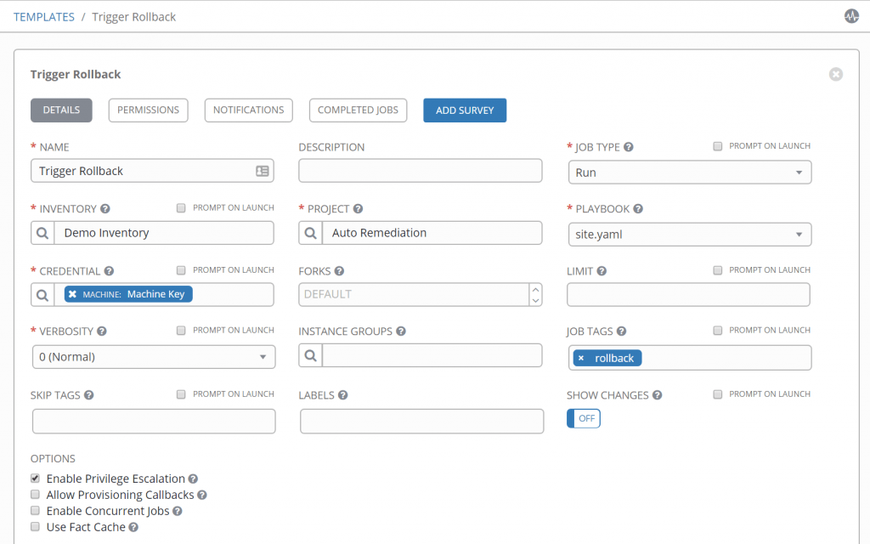
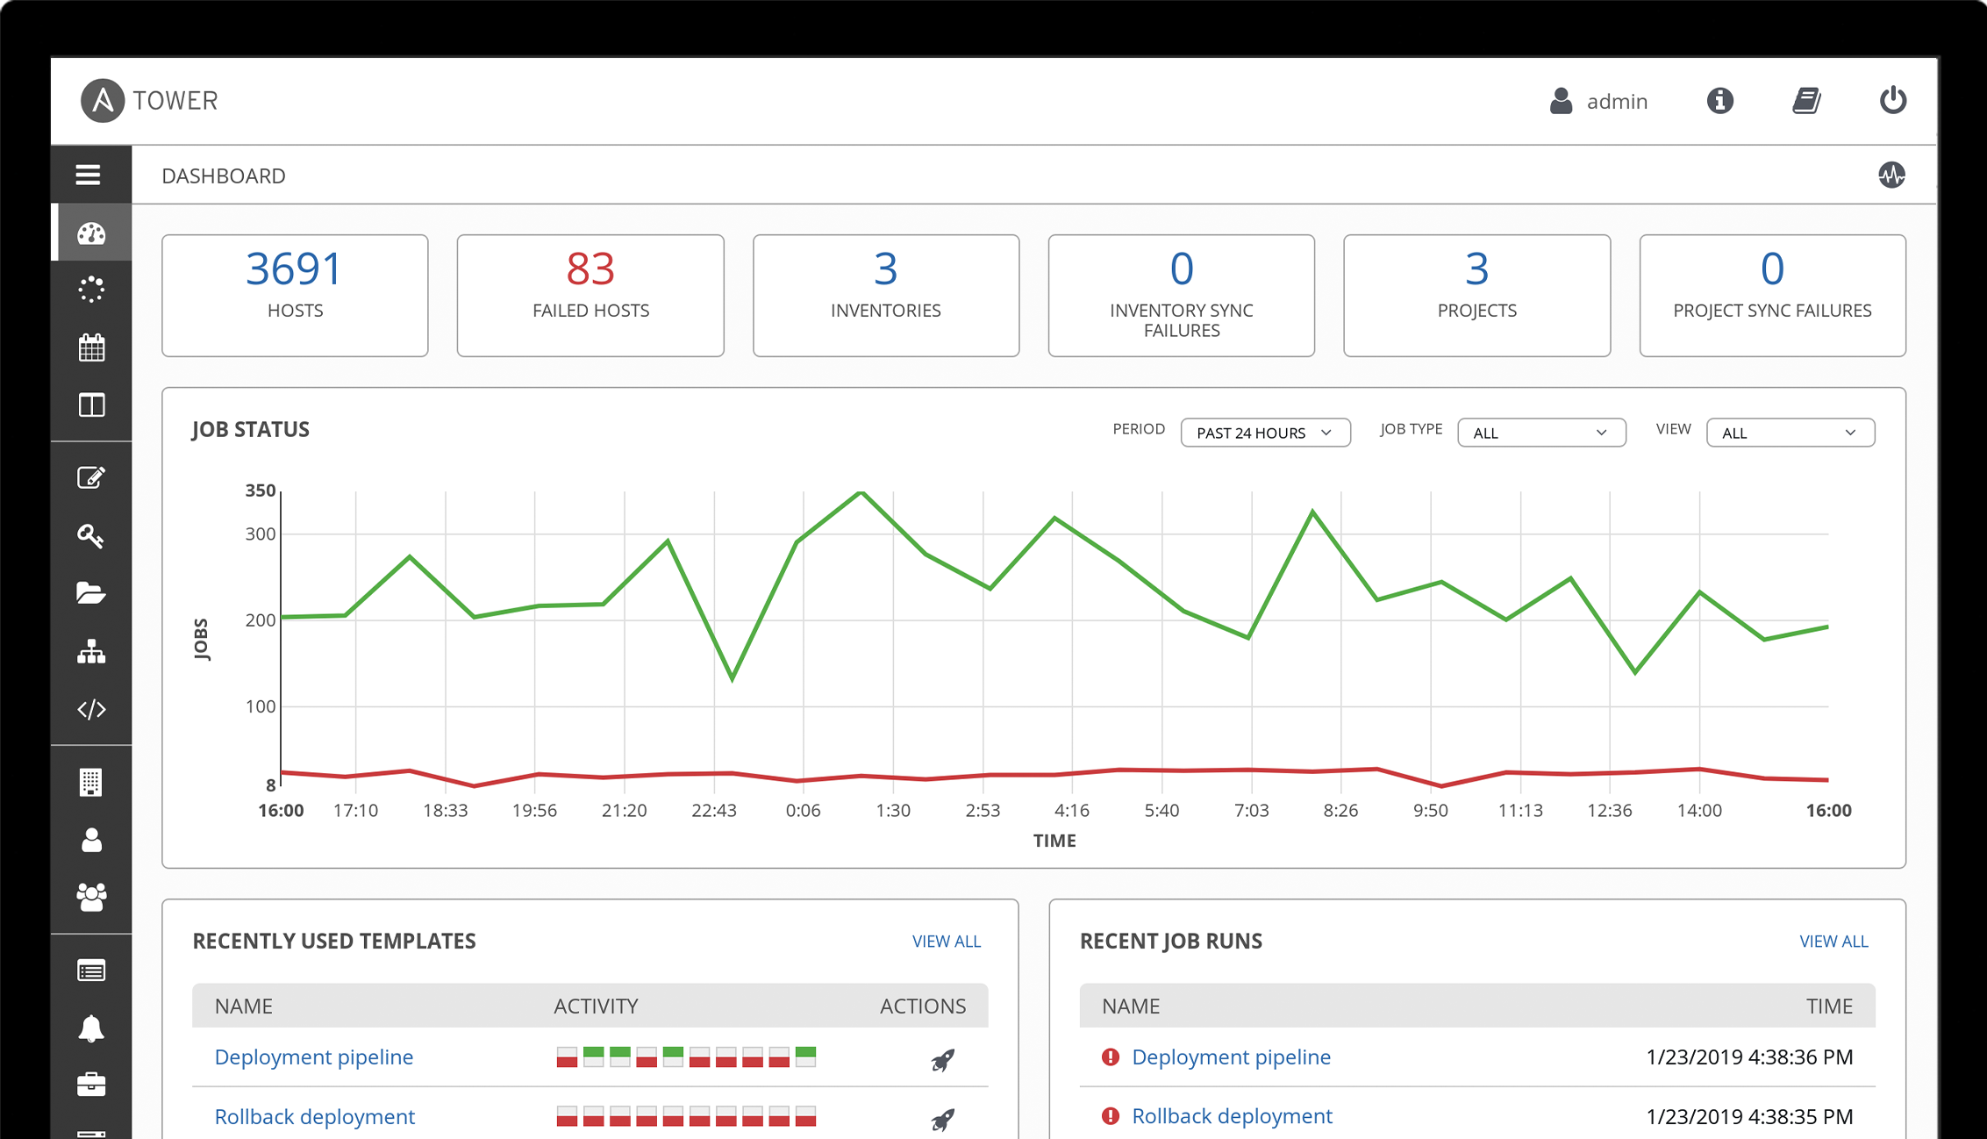
Automation with Ansible: vocabulary
Ansible Tower is a graphically-enabled framework accessible via a web interface and a REST API endpoint
(AWX is the Community Edition and works on Linux/Mac)

